Slide 1
Query Workflow

Slide 2
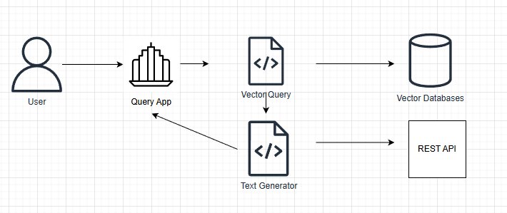
High-Level Query App Design

Slide 3
Query Architecture
User queries data and fetches relevant documents
User is a authenticated role.
Access to query results is granted based on role.

Slide 4
Documents are Source of Truth
Query uses vector databases.
Documents are the only source of truth.
Vector databases can be recreated from documents any time.
This allows to implement different vector databases for different user groups.

Slide 5
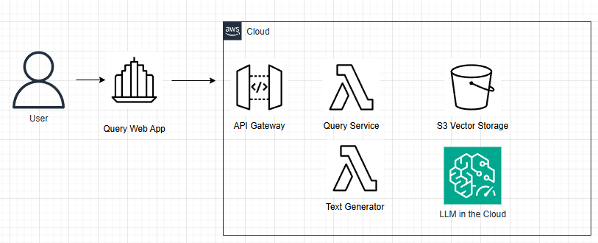
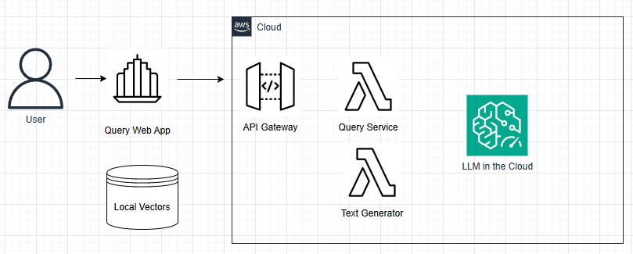
Hybrid Query Architecture

Slide 6
Notes on Hybrid Design
Vector databases are under organisation control.
Solution uses Cloud-deployed LLMs.
Business logic part can be deployed serverless in the Cloud.
This allows to scale query access.

